Slide 1
Introduction to air sensors: measurement principles, correction factors, and networks
Prof. Dan Westervelt
Columbia University, Lamont-Doherty Earth Observatory, New York, USA (primary appointment)

Slide 2
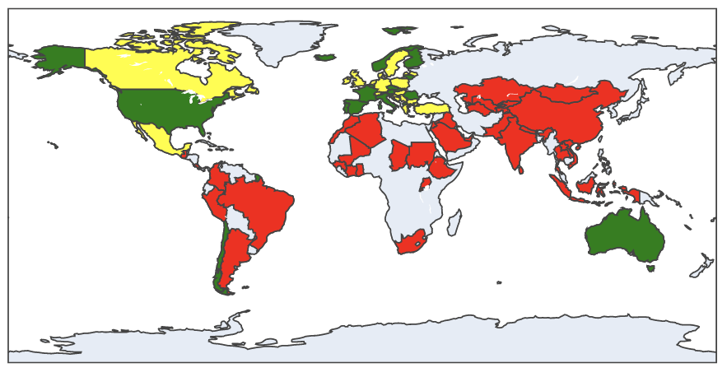
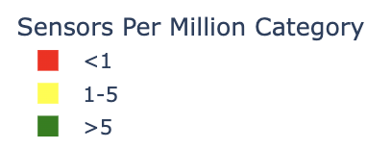
High quality air pollution data is sparse globally
PM_{2.5} (fine particulate matter) monitors per million people, 2022 (data from OpenAQ)
“You can’t manage what you don’t measure”
Raheja et al. (2025)

Slide 3
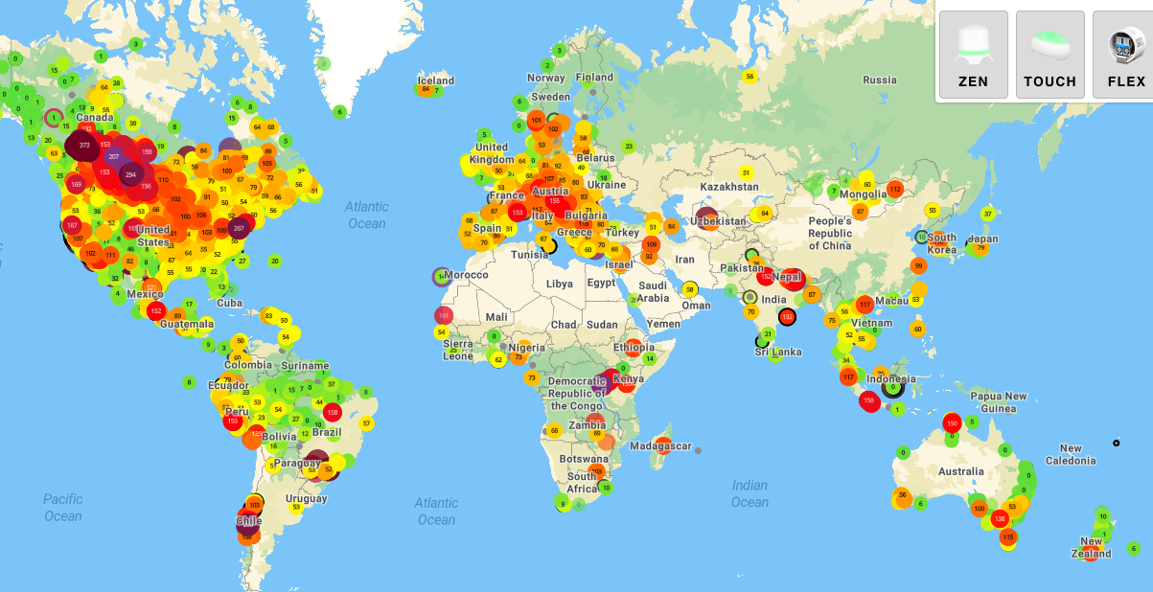
Air sensors are one of a few options for better data democratization, with caveats
Map from PurpleAir, accessed June 9 2025

Slide 4
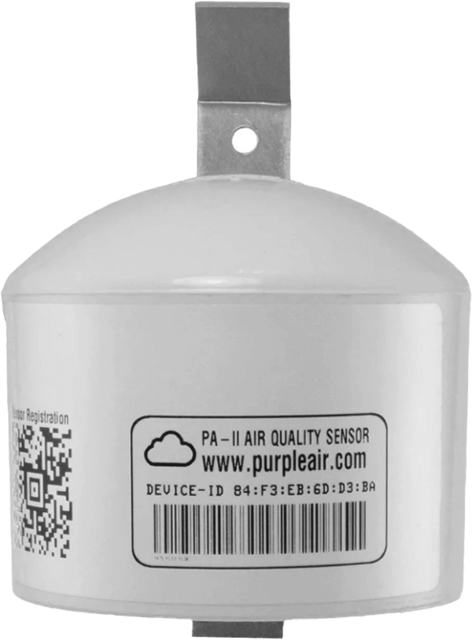
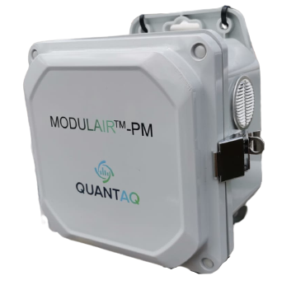
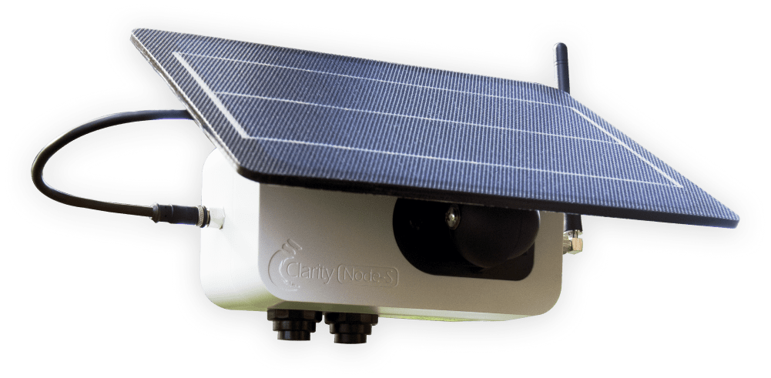
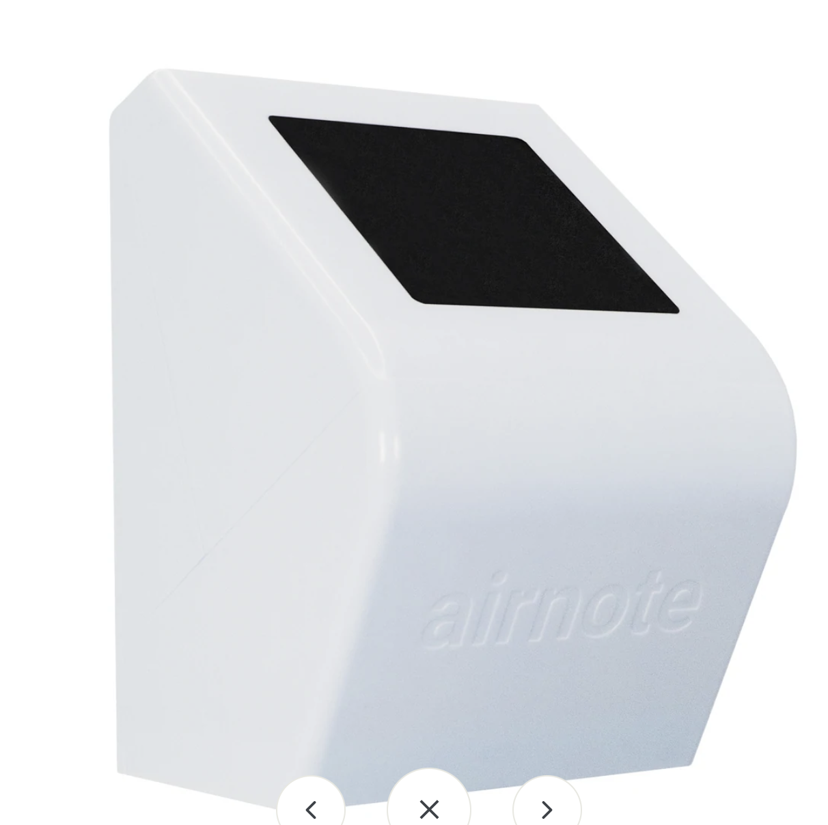
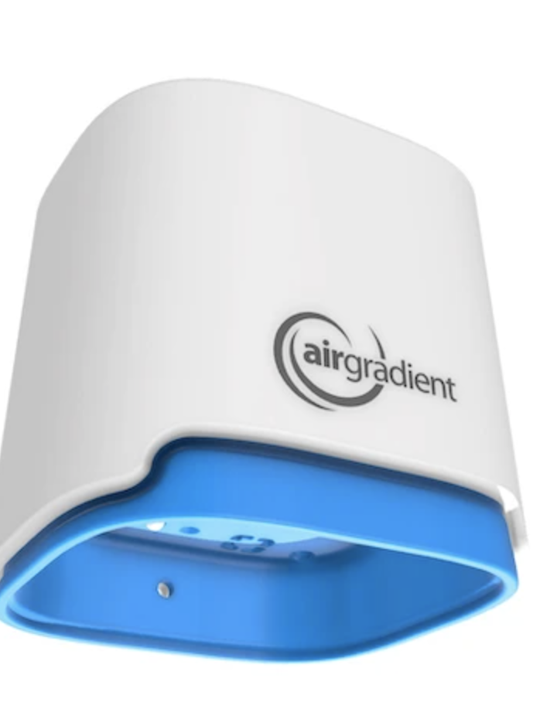
Commonly used air monitors: “low cost” sensor systems and “reference” monitors
Modulair
Clarity
PurpleAir
Airnote
Airgradient
$2000
+$300/yr
$1400/yr
$260
$200
$150
$20,000
(+shelter, maintenance, consumables, power, etc.)
$50k?
Reference or
research-grade monitors
Notes:
Reference monitors can be prohibitively expensive (MetOne Beta Attenuation Monitor (BAM) 1022 ~ $25,000)
Low cost sensors may be an alternative
Dense urban networks of low cost air pollution monitors have the potential to revolutionize regulatory action for air quality improvement, but there are caveats

Slide 5
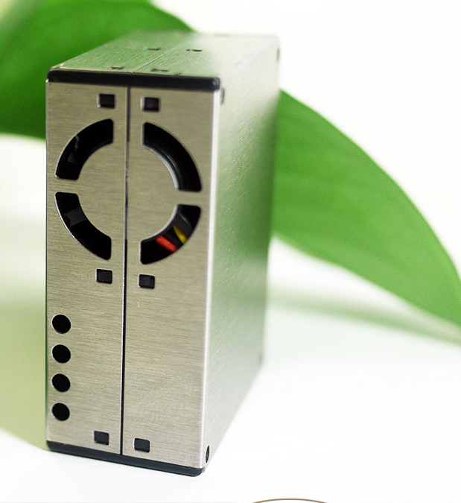
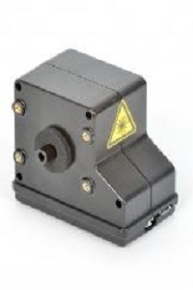
Two classes of PM sensors
Truncated nephelometers
Measure the scattering particles as an ensemble
“Truncated” because cannot see full range of scattering angles due to sensor geometry
Only useful from ~200 nm to 1 µm
Plantower-based devices, including PurpleAir, Clarity, RAMP, Airnote, others…
Shinyei, Sensiron are also nephelometers and behave similarly as a Plantower
Optical particle counters
Measure individual particles by detecting individual pulses of light from each particle.
Provide information on number and size from 350nm to 40 µm (24 bins)
Better at supermicron particles (thus PM10)
Alphasense OPC-N3
$20!
~$200

Slide 6
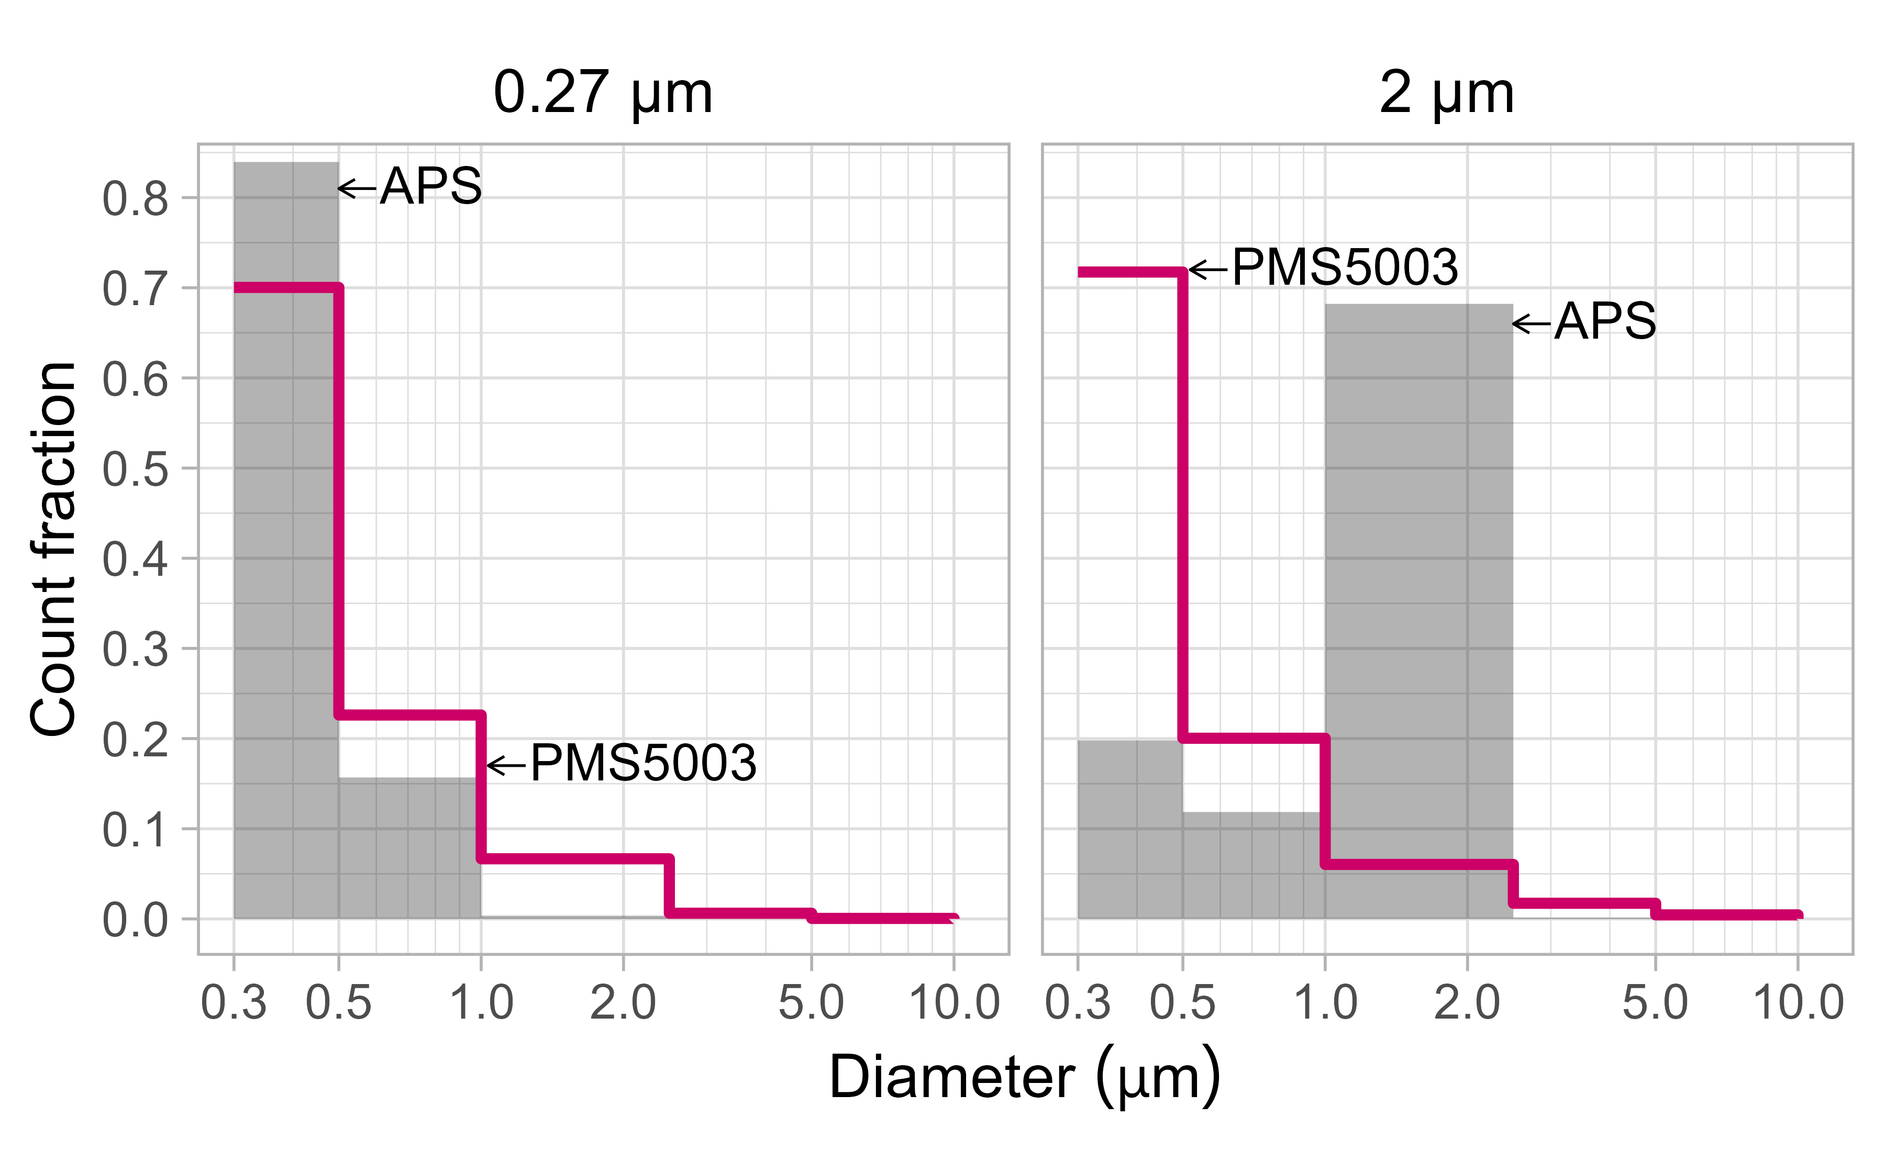
Research-grade particle sizer
(low cost nephelometer)
Research-grade particle sizer
(low cost nephelometer)
Slide from Jess Tryner

Slide 7
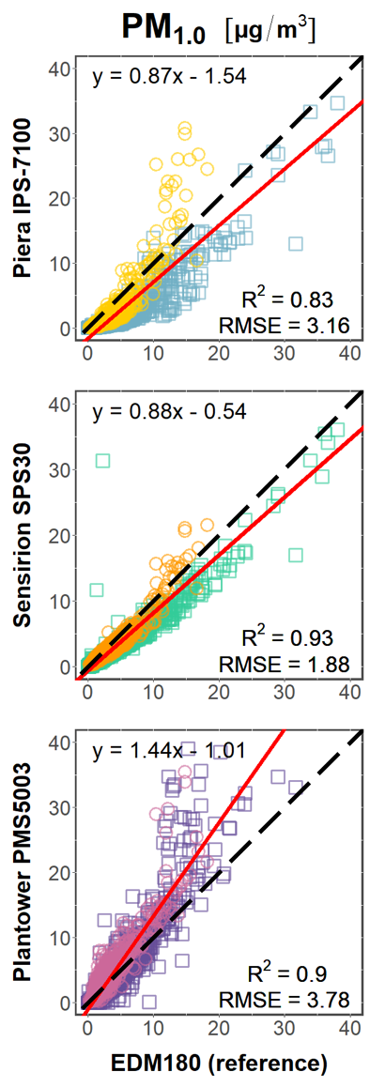
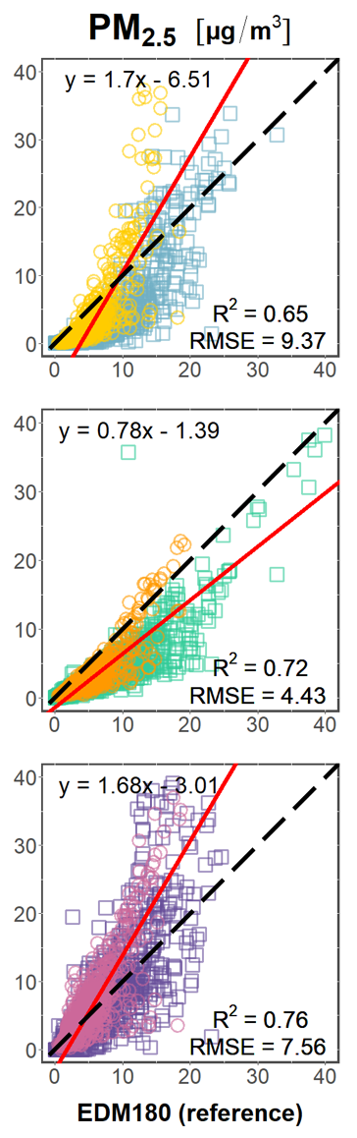
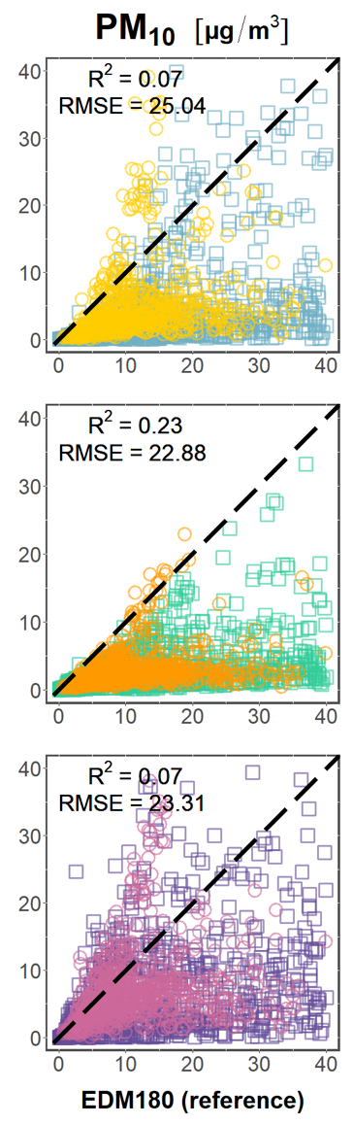
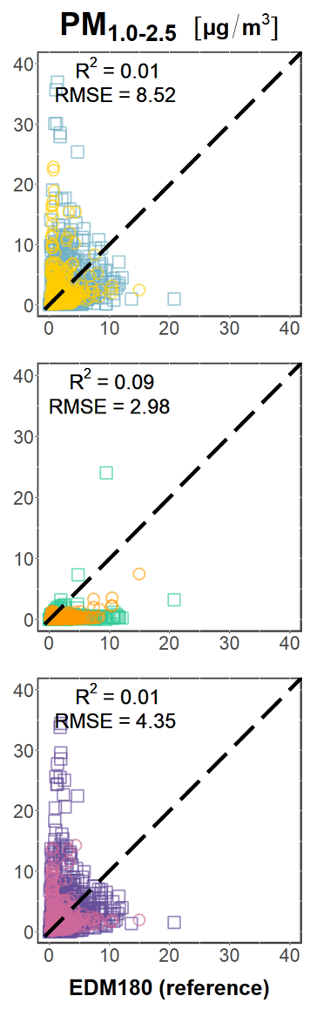
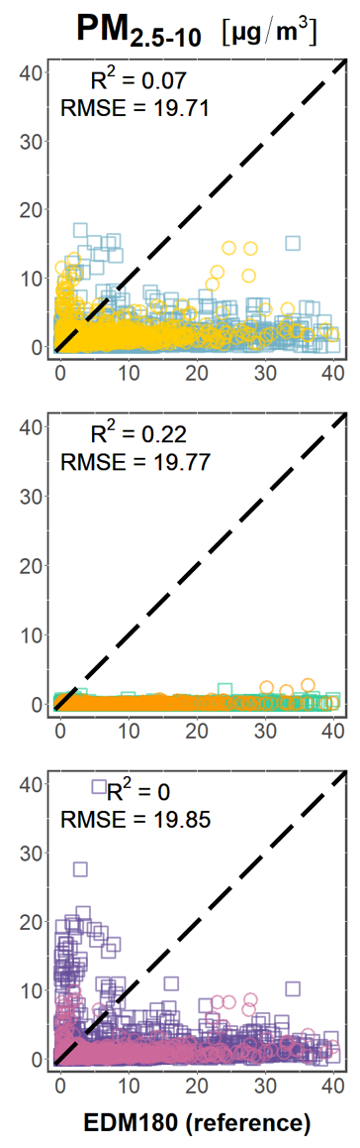
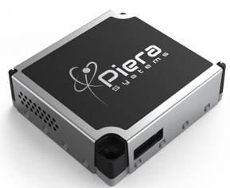
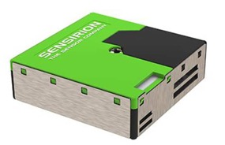
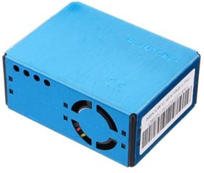
Molina Rueda et al. ES&T Lett. (2023)
See also: Kosmopoulos et al. STOTEN (2020)

Slide 8
Pros/cons of each type
Nephelometer-type
Fairly skilled at measuring sub-micron aerosol, thus work well for PM2.5
Cannot measure particles >1 µm, so cannot be used for PMcoarse or PM10 studies
OPC
Not as accurate for PM2.5
Much better for PMcoarse or PM10
Gives some limited size distribution information
Using both for the best of both worlds?

Slide 9
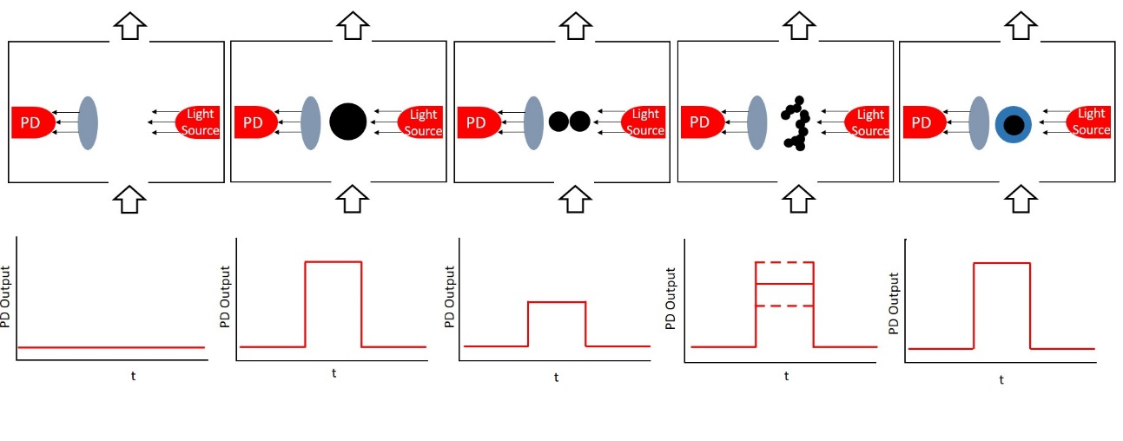
Sensor Sensitivities - PM
Anything that changes how light interacts with a particle
From Mie Theory, this means anything that changes the refractive index of a particle:
Shape
Size
Composition
Humidity
Giordano et al. 2021

Slide 10
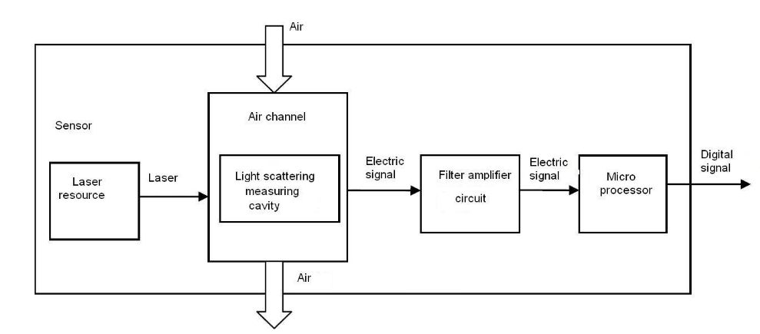
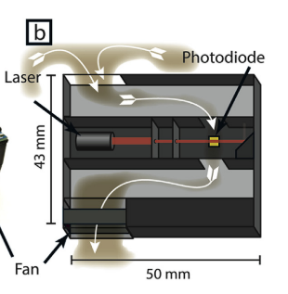
PM Sensors – Principle of Operation (nephelometers)
Functionally these photodiodes are measuring extremely small voltage changes and generally require an amplifier circuit of some sort.
Some sensors will also have a microprocessor to calculate certain outputs (e.g. size bins, automatically applied calibrations)
Slide courtesy of Mike Giordano

Slide 11
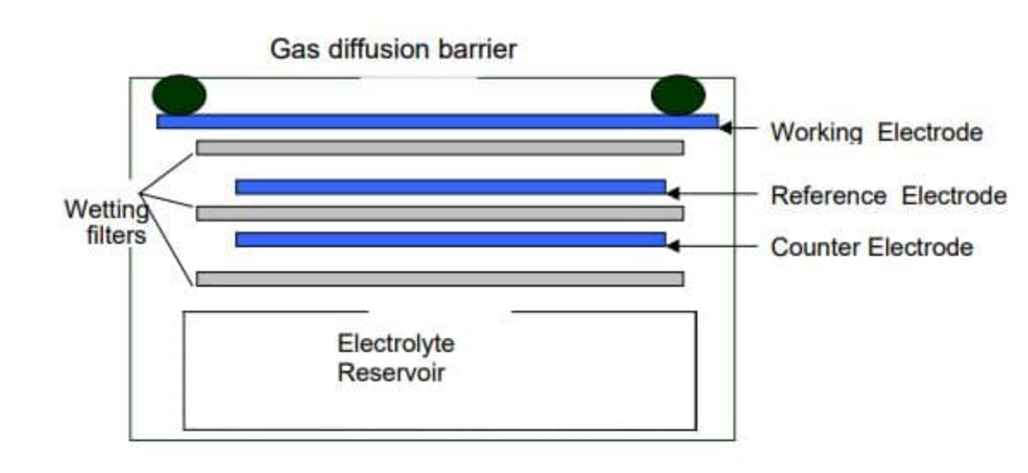
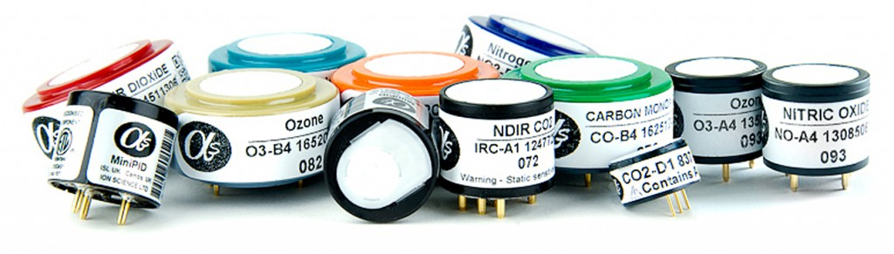
Gas Sensors
Low-cost gas sensors, generally refer to either electrochemical or metal-oxide sensors
Electrochemical: gas molecules diffuse through a selective barrier and go through a reduction or oxidation reaction on an electrode to create a current
Metal-oxide: gas molecules adsorb onto a selectively porous layer and change the electrical resistance of the layer
Typical Electrochemical sensor (Alphasense “How Electrochemical Gas Sensors Work”)
20mm (~0.8 in) diameter

Slide 12
Slide from Jess Tryner
Particle inlet
(one at a time)
Basic Optical Particle Sensor
Light Source
Light Stop
θ
Lens
Intensity
Collimator
Light Detector
Time
Notes:
Optical particle counters can do a good job of counting and sizing particles if those particles pass through the focal point of the beam one at a time.

Slide 13
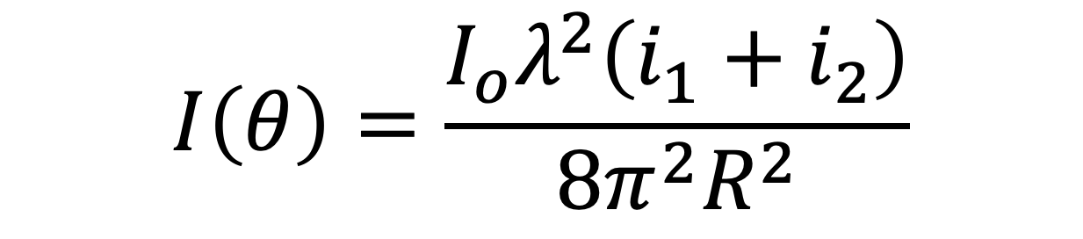
Mie theory governs particle interaction with light sources
Slide from Jess Tryner
Incident light
Intensity
Scattered light intensity
at angle 𝜽
Wavelength
$$I\left(θ\right)=\frac{I_{o}λ^{2}\left(i_{1}+i_{2}\right)}{8π^{2}R^{2}}$$
Mie intensity parameters
i₁, i₂ = f(d_{p}, λ, θ, m)
distance away from particle
???
Notes:
We can figure out particle size (if we assume a refractive index). Can figure out mass if you assume a density and shape (spherical particles).

Slide 14
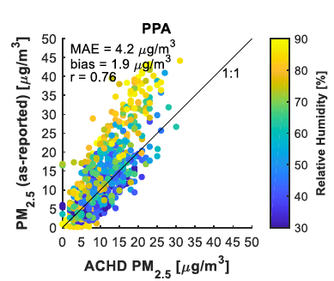
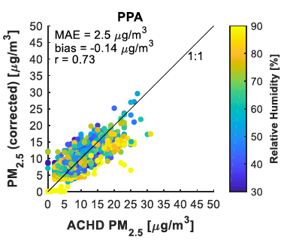
Sensor accuracy worse at higher RH
Correction
factor
Multiple Linear Regression
Data from Pittsburgh, PA
Mailings et al. (2019)

Slide 15
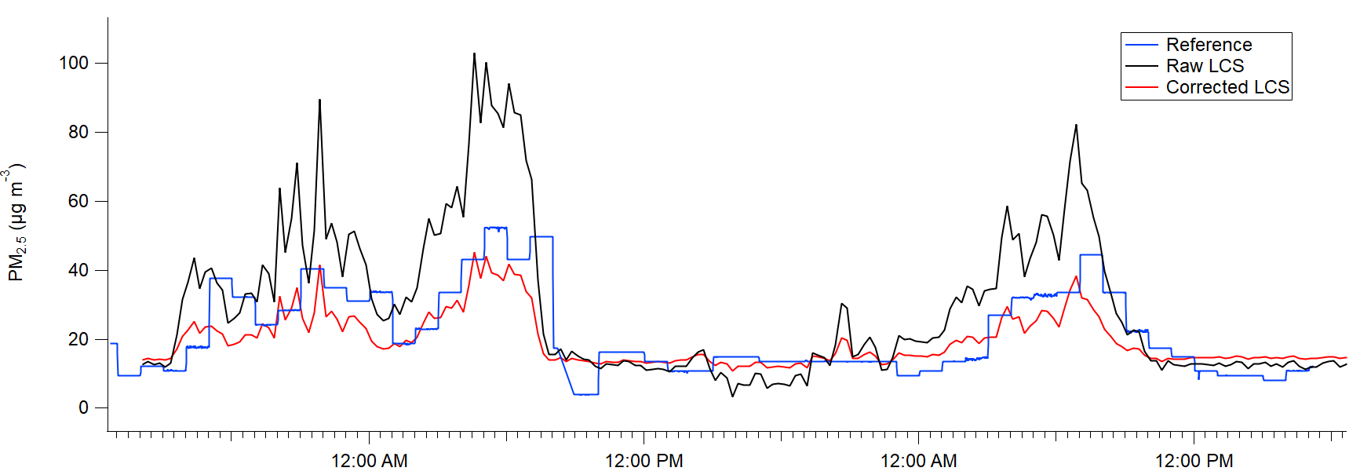
Sensor Calibrations
Goal: Be able to create a calibration model that corrects the output of a sensor for all the sensor sensitivities
How: compare sensor output to ‘reference method’ output
Reference is a term taken from the US EPA for instruments that are high accuracy and high precision and provide “true” measurements of pollutants
Can also use ‘equivalent’ methods, or research-grade instruments

Slide 16
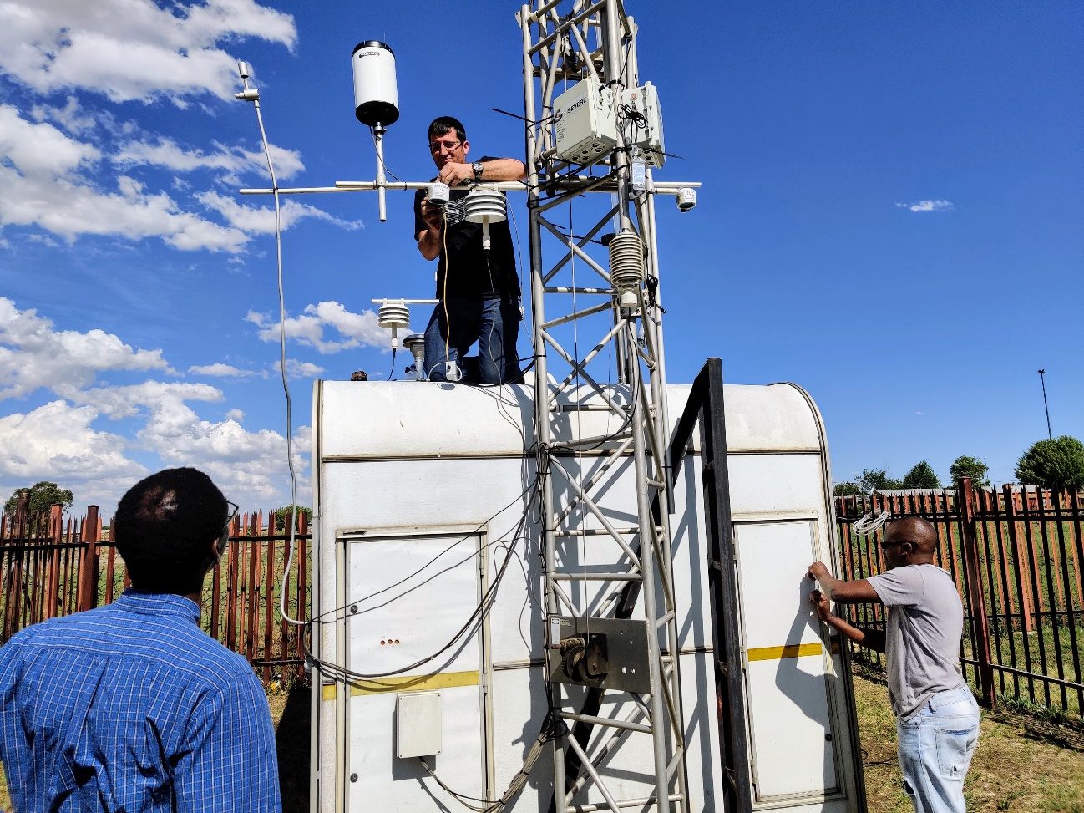
Calibration Setup
Collocation Calibration
Place both LCS and reference monitor in the same location and measure ambient pollution concentrations
Measure for a long enough period of time to capture the entire range of meteorological/other conditions expected during LCS deployment
Length of this measurement can depend on the reference method used!

Slide 17
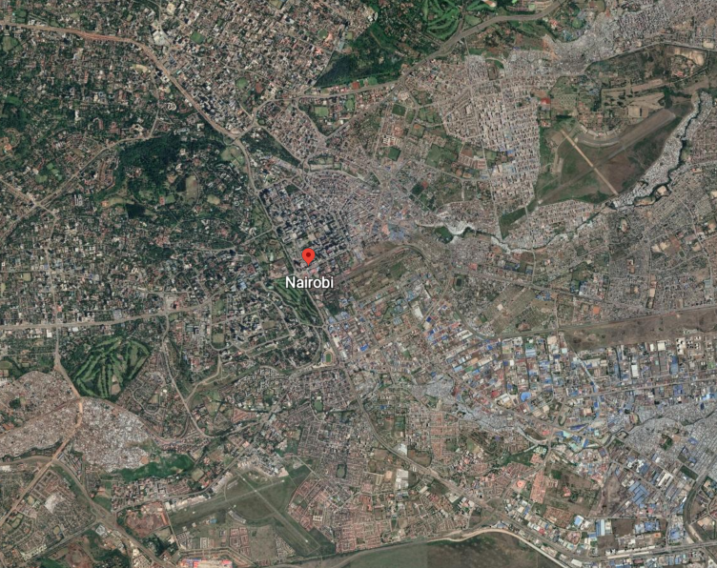
Calibration Setup
Collocation
Important points to consider when selecting a collocation location:
How long does it need to be (to get all expected conditions)?
Do all LCS need to be collocated or only a subset? (did they all pass linearity tests and agree with each other?)
Can/should it be done in multiple steps (1 in rainy season/winter/etc, 1 in dry season/summer/etc?)
Can the reference monitor move or is it fixed? Is it in a representative area for emissions for the entire network?
LCS
Reference
Deployment
See: Zimmerman et al., 2018 Atmos. Meas. Tech. (amt-11-291-2018) Malings et al., 2019 Atmos. Meas. Tech. (amt-12-903-2019)

Slide 18
Calibration Models
Simple (can be done in Excel or simple programs)
Linear model
Quadratic model
Complex (requires some coding expertise, R/python/etc)
Machine learning
Neural Network
Random Forest / XGBoost
Gaussian Mixture Regression
Other
Hygroscopic corrections (for PM)
?

Slide 19
Calibration Models - Variables
Example for PM sensors:
Sensor PM, Temperature, and relative humidity are generally good variables that tend to give good agreement with reference monitors
So a linear calibration model would be:
$${PM}_{reference}={a∗PM}_{LCS}+b∗T+c∗RH+d$$

Slide 20
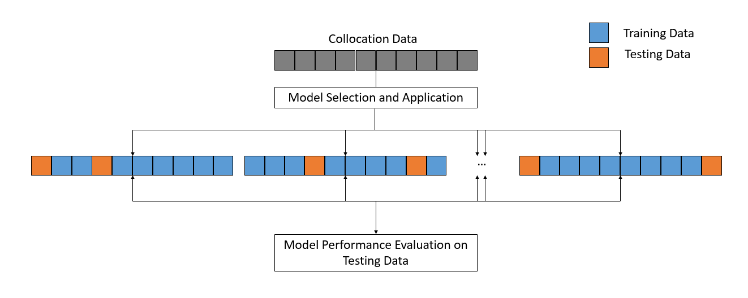
Calibration Models - Validation
K-fold cross validation – used to make sure that a model (and input variables) that you selected performs well without being biased
Easy to do – some data from the collocation is reserved (testing data) and not used
The model is tested on that data and performance is recorded
A different subset of testing data is then selected and performance recorded on that.
Repeat k times

Slide 21
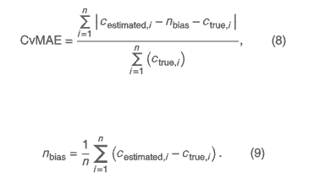
Model validation and performance
These are largely independent of what statistical method you choose (linear regression or machine learning)
Correlation – R or R² gives strength of association between two variables
Bias or error:
Mean Absolute Error (MAE) or Root Mean Square Error (RMSE)
Normalization is important so result
is comparable. CvMAE
(Coefficient of Variation of MAE)
Notes:
the average of the absolute differences between the estimated and actual values divided by the mean of the actual values

Slide 22
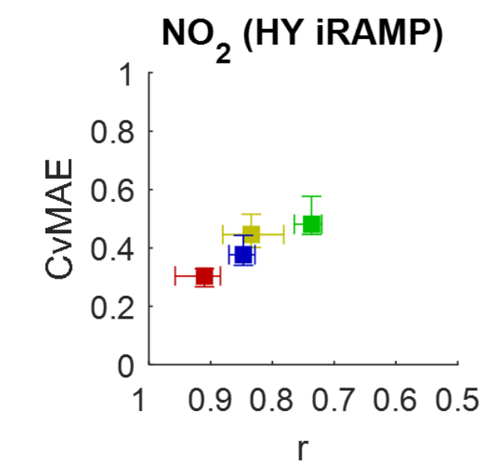
Model Performance
Mean normalized Bias:
Gives an impression of the long-term accuracy and/or stability of the measurements
Lower is better
Pearson R:
Measure of correlation between observed and modeled values
Higher is better
Bias-Corrected Coefficient of Variation of the Mean Absolute Error (CvMAE)
Measure of precision of model, normalized by mean and corrected for bias to account for different scales of gas/PM concentrations that models are built on
Lower is better
Ideal
Malings et al., 2019
Atmos. Meas. Tech.

Slide 23
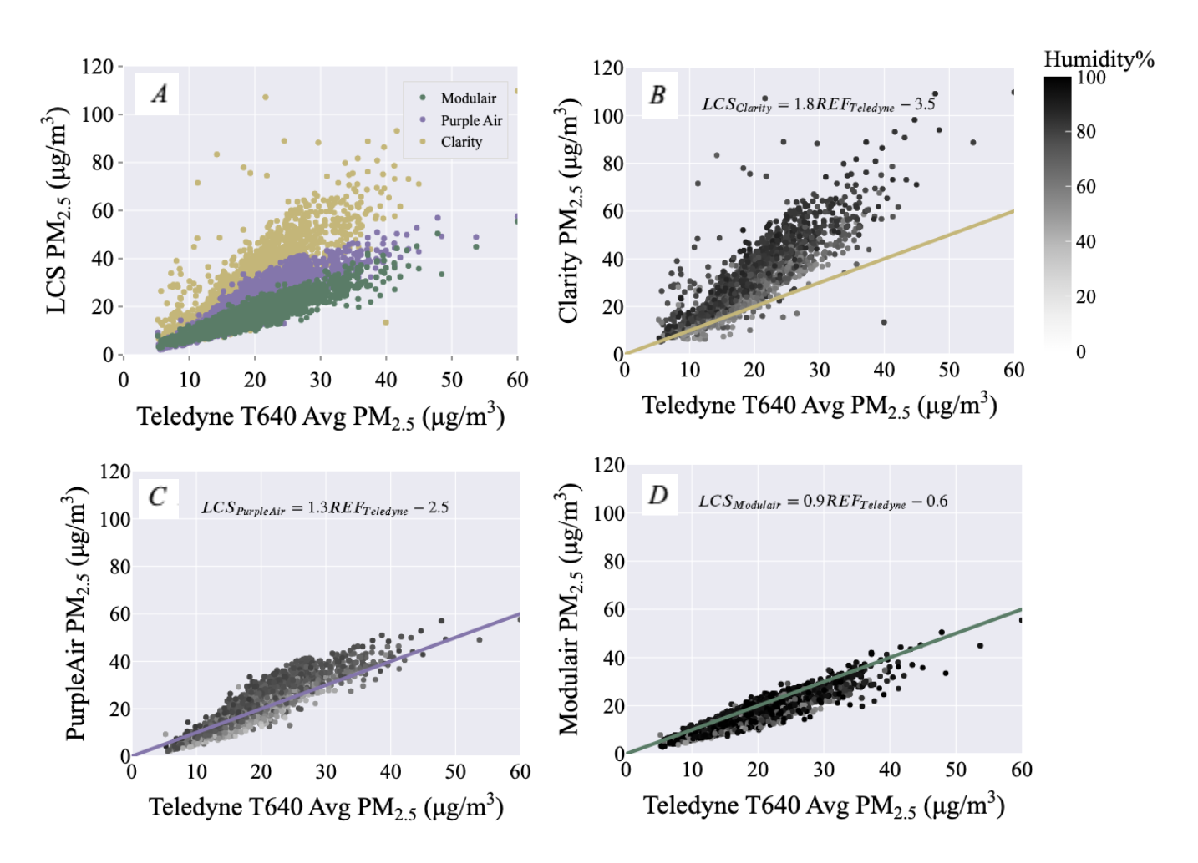

Real-world example – Accra, Ghana
Model | Purple Air |  | Clarity |  | Modulair
 | R² | MAE (μg/m³) | R² | MAE (μg/m³) | R² | MAE (μg/m³)
Manufacturer- Reported | 0.82 | 4.54 | 0.69 | 13.68 | 0.84 | 3.04
MLR | 0.87 | 1.96 | 0.74 | 2.49 | 0.86 | 2.15
GMR | 0.89 | 1.76 | 0.79 | 2.27 | 0.87 | 1.89
Clarity
Set aside some fraction of the data to as “training data” to develop “correction factor”
PurpleAir
Modulair
23
Raheja et al. (2023) ES&T

Slide 24
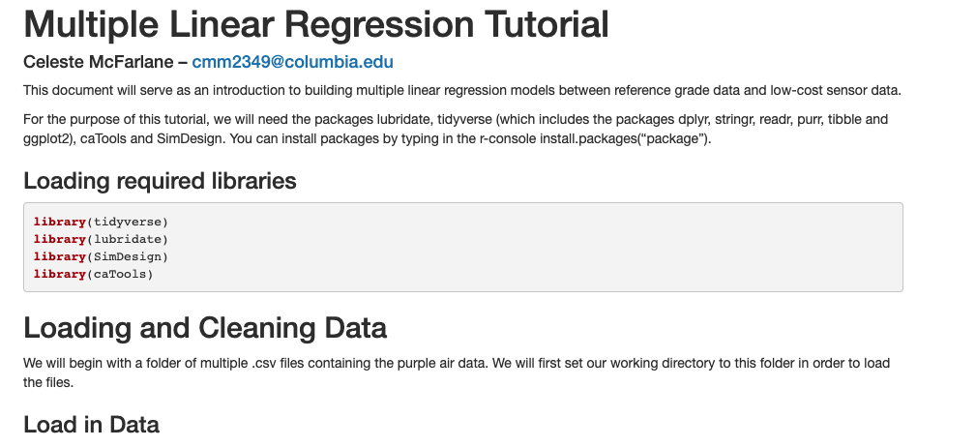
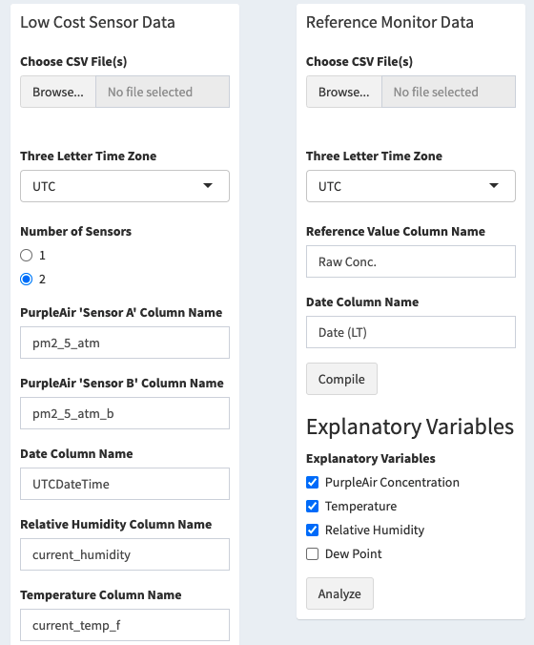

Coding (and non-coding) tutorials on this methodology
Both freely available as ShinyApps (written in R and Python)

Slide 25
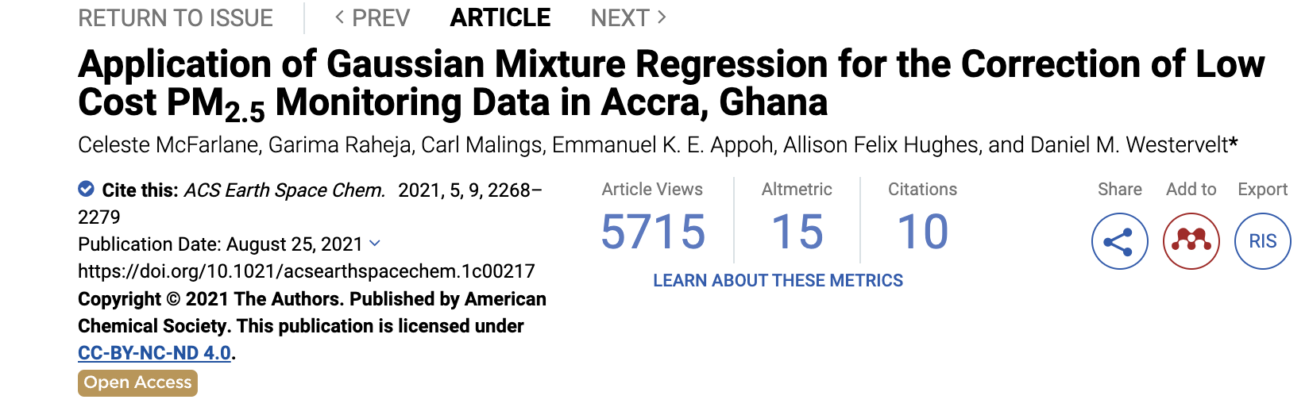
Data for this tutorial:
https://tinyurl.com/AQKNUST
Westervelt group website for more info
https://aerosol.ldeo.columbia.edu/content/resources

Slide 26
Take home points
Most air sensors are physically measuring PM₁, but can be okay for PM_{2.5} with calibration. Most air sensors are not capable of measuring PM_{2.5-10}
Important to characterize the performance and apply correction factor to your sensors. The most frequently used variable(s) for correction are the raw PM2.5 output and the relative humidity, typically measured by sensor packages.
Air sensors, when characterized and calibrated against reference monitors, can provide useful, actionable information about air quality and close the air pollution data gap

